Slide 1
Credit: ULAS
Notes:
Archaeologists get a great deal of their information from graves, such as this recently uncovered example from the Western Road site in Leicester (indicated on the map on ppt slide 2).
Scientific analysis of skeletons can tell us a great deal (perhaps ask if pupils remember what was discovered about Richard III, e.g. position of wounds, which wound killed him, what diet he had etc); isotopic analysis can give us an idea of the environment in which an individual grew up.
Several individuals in this cemetery (about 6%) may have come from, or had parents who came from, North Africa. Marcus the centurion had also served in the Roman army in North Africa. Leicester was a diverse city in Roman times too.
This is a male adult who died in his late 30s or early 40s, sometime during the 4th century AD. He had problems with his back and hips and had broken a bone in his hand before he died (healed injuries). Iron nails in the grave indicate that he was buried in a wooden coffin, and a ceramic flask had been placed beside his head as a grave offering.
More information can be found on these posters on the Western Road cemetery, which can be downloaded here:
https://ulasnews.com/poster-gallery/#jp-carousel-1387
https://ulasnews.com/poster-gallery/#jp-carousel-1388
https://ulasnews.com/poster-gallery/#jp-carousel-1389

Slide 2
Vine Street house
home of Marcus, Servandus, Nigella and the location of the
curse tablets
Western Road
Roman cemetery
Credit: ULAS
Notes:
The following video link gives ideas about the features of identity which can be assumed from grave goods – key parts are the beginning and end of the film.
https://www.youtube.com/watch?v=t-FDnhKSt5I&feature=youtu.be

Slide 3
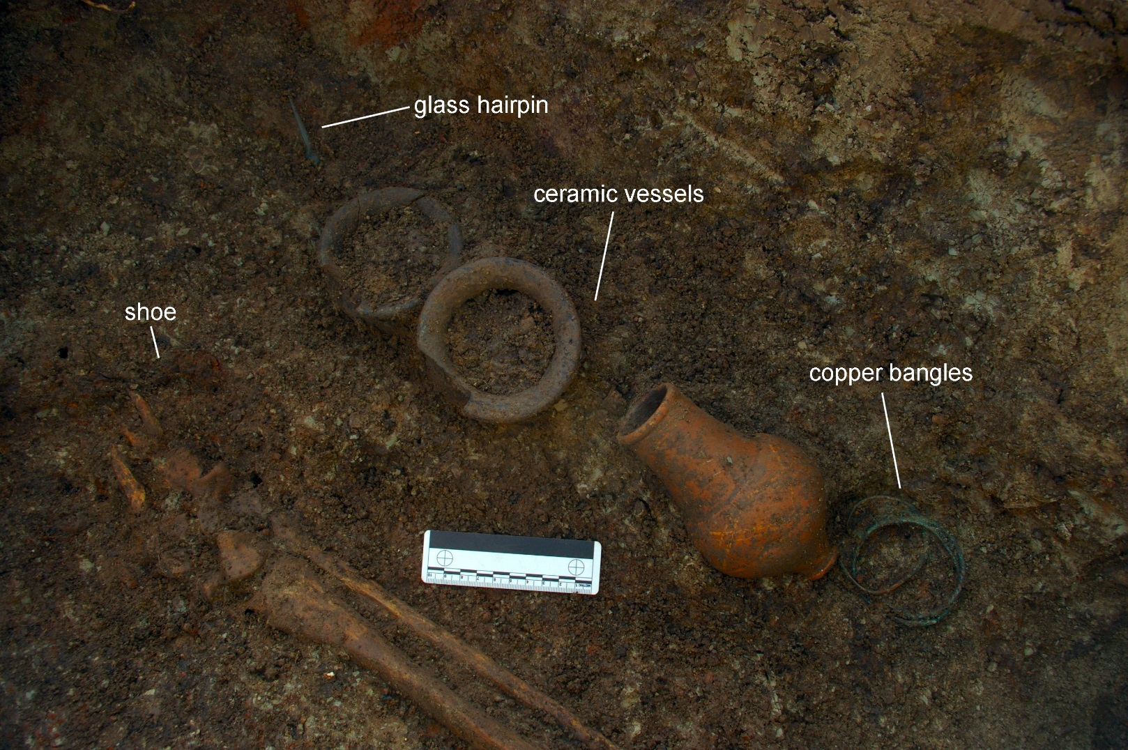
Credit: ULAS
Notes:
The grave goods in-situ came from the grave of a 16-19 year old woman in the Western Road cemetery. We know she was buried clothed inside her coffin because she was wearing shoes, and a silver chain necklace around her. Outside her coffin, next to her feet, was a large collection of grave offerings, including three ceramic vessels, four copper bangles & bracelets and a glass hairpin.
Much evidence comes from graves, which might look like the example you have set up. Identify which of these objects are likely to be genuine. Ask which objects/ materials are more likely to survive than others & what effect different conditions might have. Point out the importance of dating the grave: ask which objects can establish dates. The object framework slides are included here to guide discussion.

Slide 4
What questions can we ask an object?
What is it?
What is it called?
What is or was it used for?
Does it have more than one function?
What does it look and feel like?
How big is it?
What’s it made of?
What’s its shape, smell, and sound?
What colour is it?
Is it complete?
Has it been altered, adapted, or mended?
Is it worn?
How was it made?
Who made it?
How was it made?
Is it hand or machine made?
Does it have parts?
What does it tell you about the maker’s technical skill?
Notes:
Slides 12-13 form the Object Framework available as a word document in this pack. They are designed to help pupils develop a framework for thinking with and about objects as evidence for the world in which the objects were created (not just the Roman period).

Slide 5
What questions can we ask an object?
Does the design suit its purpose?
Were the best materials used?
How is it decorated?
What influenced its design and appearance?
What can it tell us about the society in which it was made?
When was it made?
Where was it made?
Where was it used?
Where was it found?
Who made it?
Who used it?
Who owned it?
How does it compare to similar items from other cultures and time periods?
How was it valued?
What kind of value did it or does it have? (to the person who made it; to the person who used it)
How does the object reflect the person, community, nation or culture at the time it was made?
Adapted from: Adapted by the US National Park Service, Museum Management Program from the Hands on History Program, National Museum of American History, Smithsonian Institution, Washington, DC; Museum Magnet Schools, Education Resources; English Heritage, A Teacher’s Guide to Learning from Objects; and the Victoria and Albert Museum education materials, London, England. https://www.nps.gov/index.htm

Slide 6
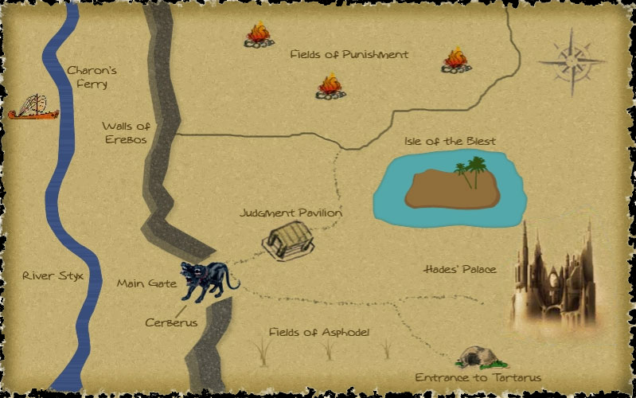
Map of the Underworld
Credit: http://rickriordan.com/extra/map-of-the-underworld/
Notes:
Ask pupils to discuss and then work out as a group which part of the Underworld (keep using the map as well as the descriptions on the board) the different grave-goods are used for: which goods get you past the ferryman (Answer: the coin; he needs paying) and the dog Cerberus (Answer: food & whatever was in the pots; he’s hungry)? How do you retain memory (photos), pass the time (games/ book) in eternity when your minds have been wiped?
Ask pupils how much indication of the identity of the owner comes from the grave goods they have already seen – is it obvious that there was a North African connection, for example? Are these goods the choice of the person in the grave or the people (family/ friends) burying them?
For other useful teaching resources linked to the Percy Jackson series of books by Rick Riordan visit: http://rickriordan.com/resource_type/teachers-guides/

Slide 7
Dis – The Underworld
“Here is a vast quagmire of boiling whirlpools which belches sand and slime into the river, guarded by the terrible Charon in his filthy rags. On his chin there grow a thick grey beard, never trimmed. His glaring eyes are lit with fire and a foul cloak hangs from a knot at his shoulder. With his own hand he plies the pole and sees to the sails as he ferries the dead in a boat the colour of burnt iron.
The kingdom on this side resounded with barking from the three throats of the huge monster Cerberus lying in a cave in front of them. When the priestess was close enough to see the snakes writhing on his neck, she threw him a honey cake. He opened his three jaws, each of them rabid with hunger, and snapped it up where it fell.
They entered the land of joy, the lovely glades of the fortunate woods and the home of the blest. Here a broader sky clothes the plains in glowing light, and the souls have their own sun and their own stars. Some take exercise on grassy wrestling-grounds and hold athletic contests and wrestling bouts on the golden sand. Others pound the earth with dancing feet and sing their songs.
These are the shades to whom Fate owes a second body. They come to the waves of the river and drink the waters of serenity and draughts of long oblivion ... so that they may go back and see the vault of Heaven again remembering nothing.”
Notes:
This passage comes from Virgil's Aeneid book VI (http://www.poetryintranslation.com/PITBR/Latin/VirgilAeneidVI.htm#anchor_Toc2242928), in which the hero Aeneas visits the Underworld to seek advice from his dead father, Anchises. Here we see the Disney-like description of Charon (the Underworld sections of Hercules give a good general idea) who rowed dead souls over the River Styx to the Underworld if they had a coin buried with them.
Souls first had to get past the three-headed watchdog, Cerberus, for which they needed some food; the origin of the phrase 'a sop for Cerberus'.
After this souls would be assessed to work out which section of the Underworld they would enter. Evil souls entered Tartarus, the area of eternal punishment; punishments included Sisyphus being forced to push a rock up to the top of a hill; the rock always rolled back to the bottom. Most souls entered the oblivion of the Asphodel Fields, for which they would need reminders of themselves (eg photos) and games/ books to pass the time. Heroes and heroines entered the paradise of the Elysian Fields, which was much more fun (see para 3 in this slide), at least as far as the Romans were concerned.
Credit: Poetryintranslation.com. Open-access translations of classic texts freely available for non-commercial use.

Slide 8
Dis
“Charon sum. ratem trans Stygem navigo. ratis antiquus et fractus est. donum mihi habes? nunc Stygem transimus.
Cerberus canis est. Cerberus Ditem vigilat. canis ferox quod ieiunus est. Cerberus cibum vult. donum ei habes? nunc Cerberum praeterimus.
tres regiones in Dite sunt. pessimi ad Tartarum eunt. optimi ad Elysium eunt. reliqui ad campos eunt. diu in campis habitas. ludum habes?
nunc umbra es. umbrae in campis habitant. umbra memoriam non habet. commemorationem habes?”
Useful Words
ratis, em: boat Styx, Stygem: River Styx donum: gift
mihi: for me habeo/s/t: I/you/(s)he has nunc: now
Dis, Ditem: Underworld canis, em: dog ieiunus: hungry
cibus, um: food vult: wants ei: for him
praterimus: we go past eunt: go reliqui: the rest
campus, os, is: fields diu: for long time ludum: game
umbra: shade, ghost
Notes:
Extension activity. Translate the passage to create a map. Many of the words are not included in the vocabulary to encourage pupils to guess from derivatives, e.g. antiquus: old – antique; fractus: broken – fracture. Remind pupils to look for the verb at the end of the sentence, and the end of the sentence for the verb ending: -o: I, -s: you, -t: he/she/it, -mus: we, -tis: you (plural), -nt: they
Translation reads: I am Charon. I sail a boat across the River Styx. The boat is old and broken. Do you have a gift for me? Now we cross the Styx.
Cerberus is a dog. Cerberus guards the Underworld. The dog is fierce and hungry. Cerberus wants food. Do you have a gift for him? Now we go past Cerberus.
There are three areas/ regions in the Underworld. The very bad people (cf pessimists think the worst) go to Tartarus. The best go to Elysium. The rest go to the fields. You live in the fields for a long time. Do you have a game?
Now you are a shade/ ghost. Ghosts live in the fields. A ghost does not have a memory. Do you have a memorial/ something to help memory?

